Slide 1

SnackBar Inc.
2021 Mid-Year Sales Data Insights
Prepared by mariah

Slide 2
Objective
The report is based on Sales Data for Jan to June 2021
The objective is to :
Uncover key trends and patterns across regions
Identify top performing segments and profitability drivers
Highlight actionable insights to improve sales play book

Slide 3
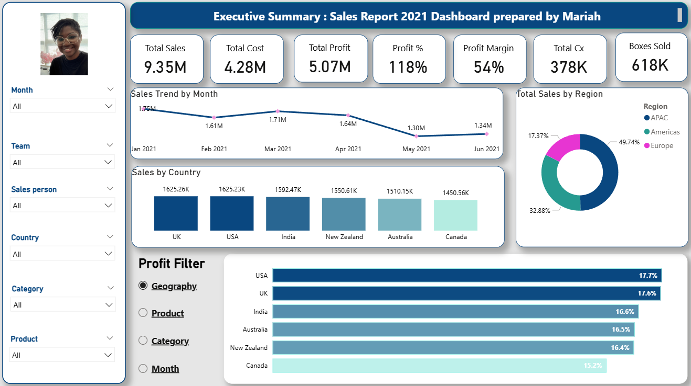

Slide 4
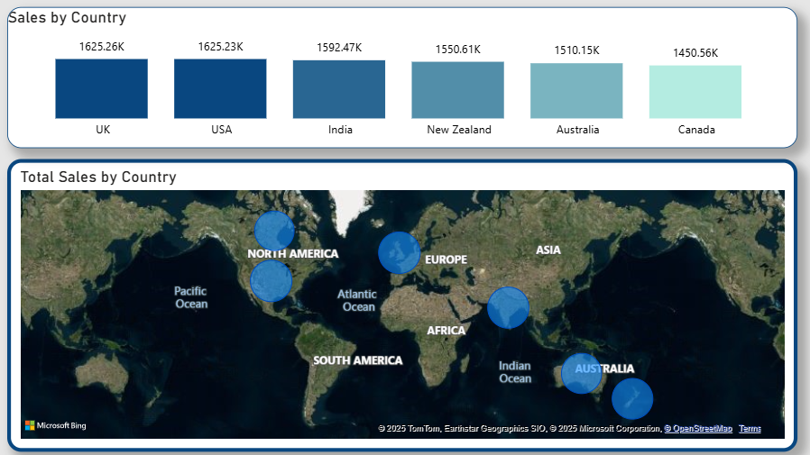
Region Analysis
UK is the top selling country
USA is the most profitable country due to efficient cost structure
India shows emerging market potential for growth

Slide 5
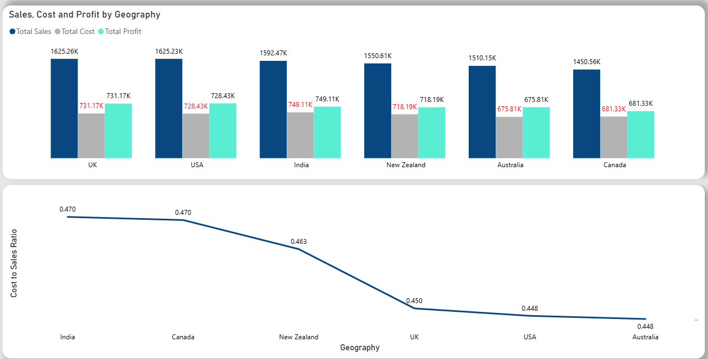
Analysis cont’d
Although UK has the highest sales USA has the lower cost yielding a higher profit percentage

Slide 6
Product Analysis
SnackBar Inc sells 22 products across 3 Categories.
Bite category leads with 57% of total profit, this indicates strong market demand for the product under this segment.
Highlights
Smooth Sliky Salty is the highest earning product
Peanut Butter is Cubes is the most profitable product overall.
Afternines is the highest selling by volume but also scores the lowest profitability

Slide 7
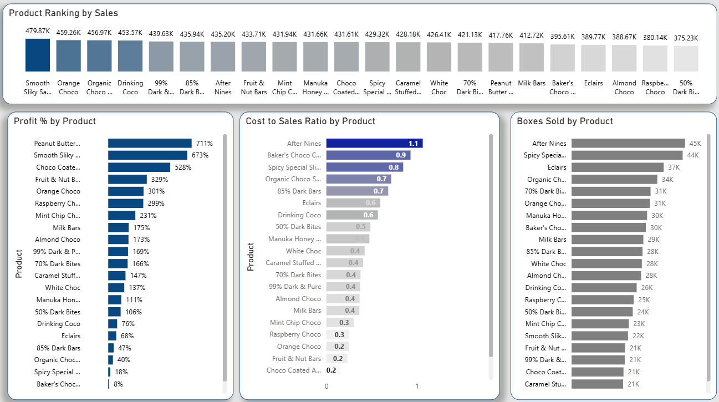
Analysis cont’d

Slide 8

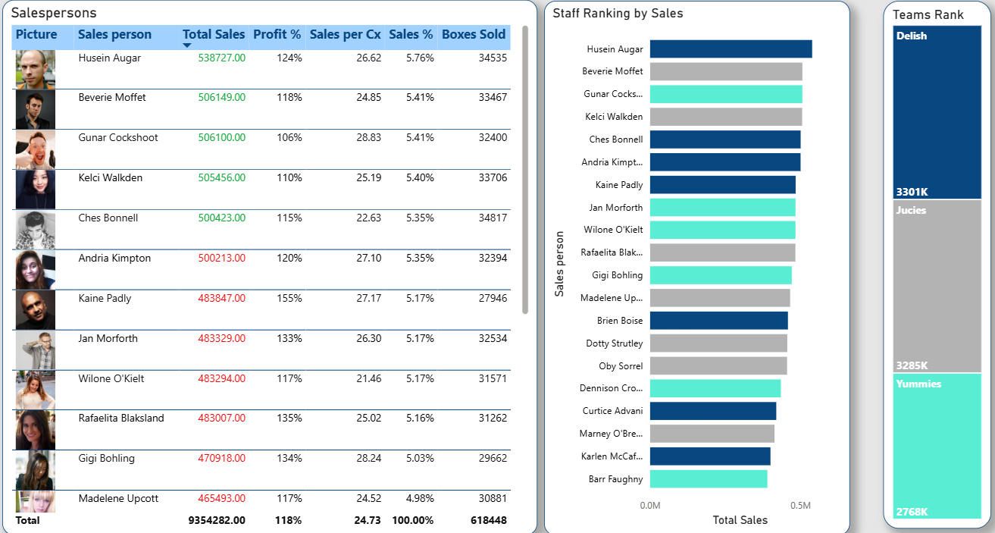
Staff Performance
First Last
First Last
First Last
First Last
First Last

Slide 9
Highlights
Key Observations
Recommendations
High sales volume doesn’t mean High Profitability.
Bites category dominates profit contribution.
Cost structure impacts Afternines, making it least profitable
Opportunities exist in optimizing costs and expanding the profitable segments
Replicate US Cost efficiency model across other countries
Expand the Bites Category to maximize profitability.
Strengthen product sales strategy to drive the volume sales of Peanut Butter Cubes and Smooth Silky Salty.
Review the production cost of Afternines
Invest in India and New Zealand to capture growth opportunities.

Slide 10

Questions?

Slide 11
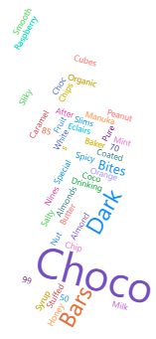
Thank you
Questions?

